Slide 1

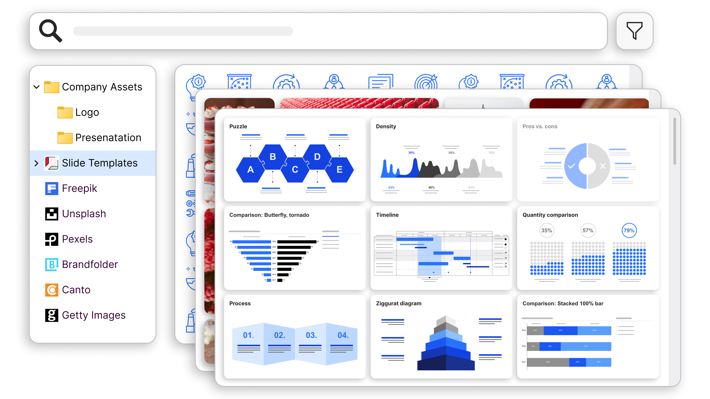
Quick start guide

Slide 2



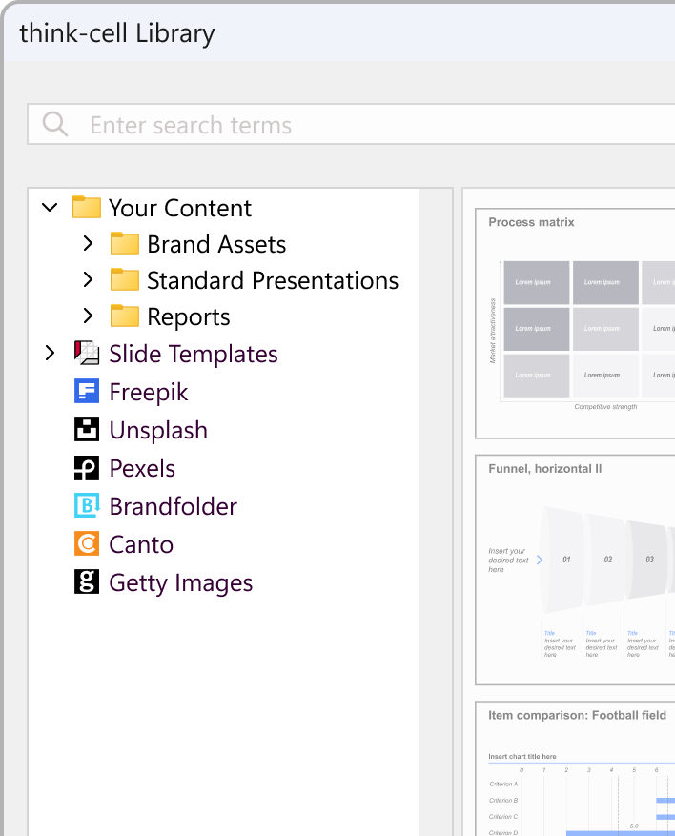
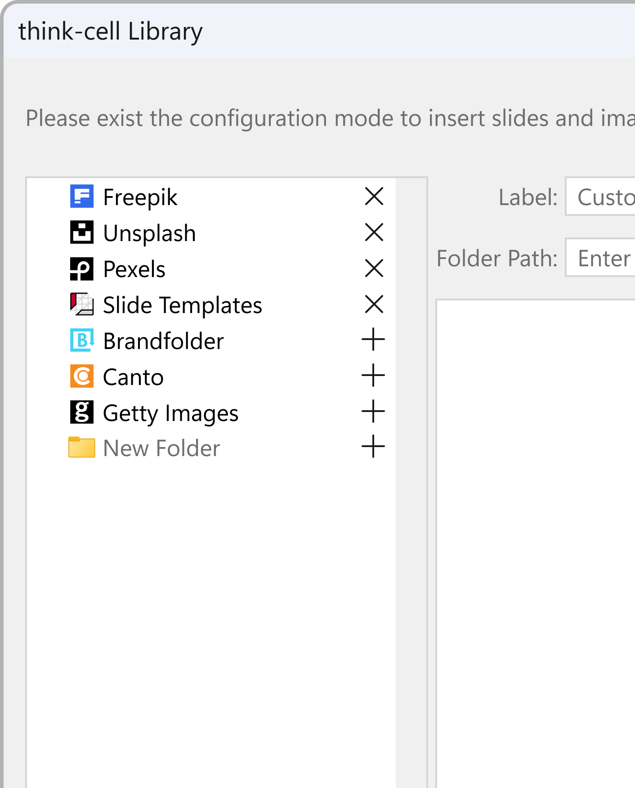
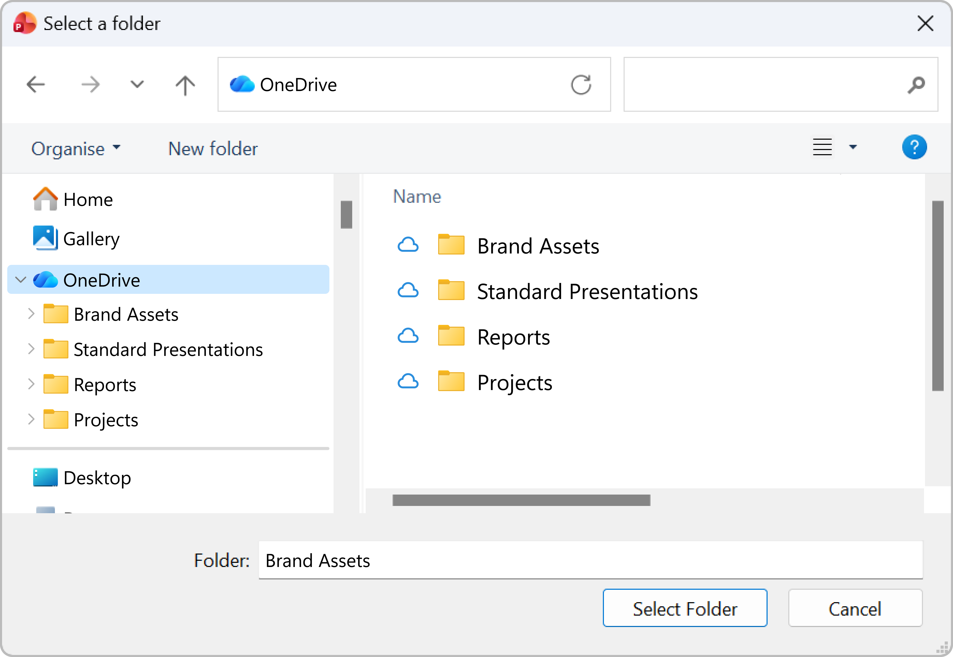
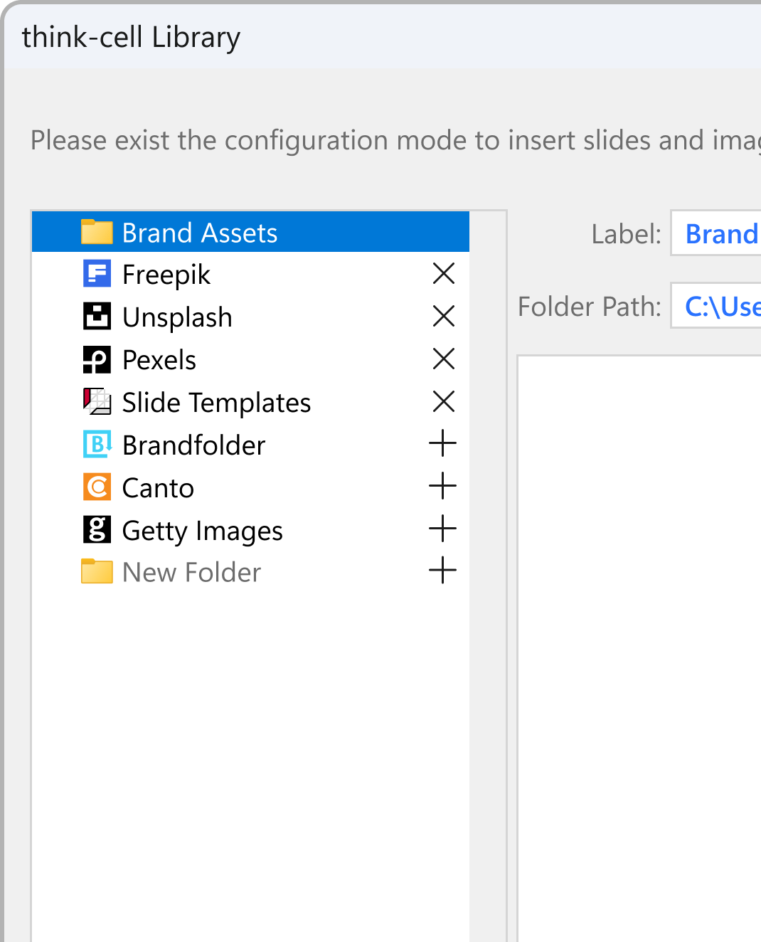


Adding content to think-cell Library
Access your slides, and images from your computer, network, or OneDrive
1
2
3
4
Select Configure Library at the bottom to start setting up your library content.
Select New Folder
The file explorer will launch automatically.
In the folder picker, select a folder, then press the Select Folder button.
Select Save Configuration
at the bottom to complete the setup.

Slide 3
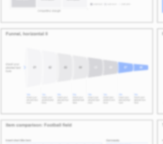

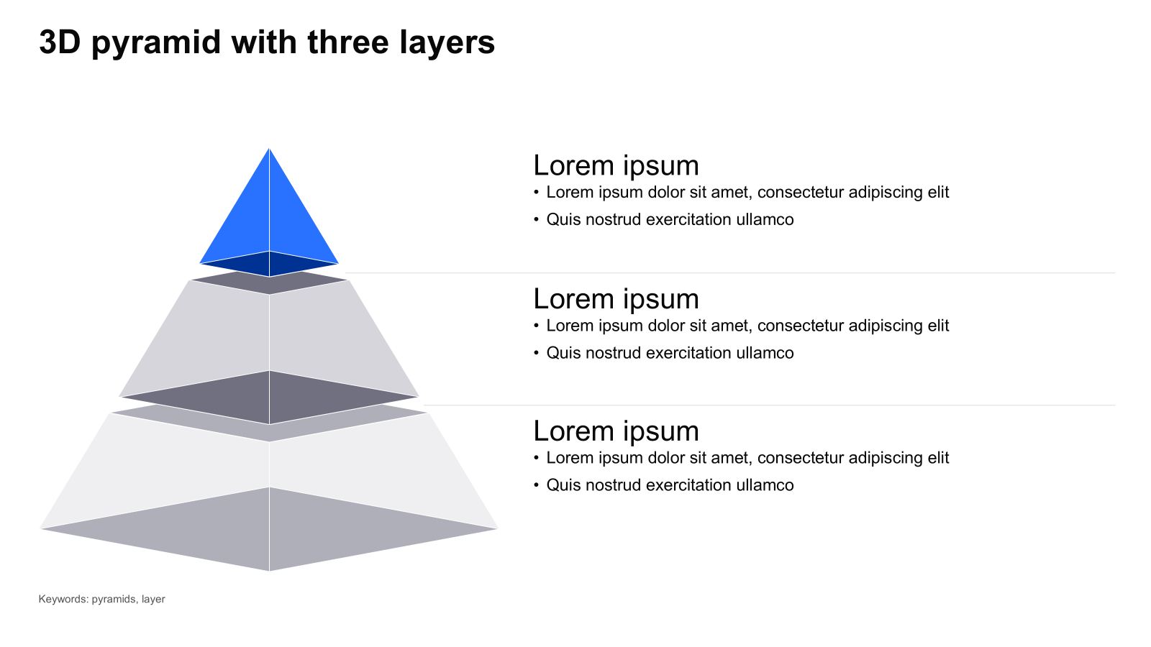

Inserting slides, templates, or elements
Hover over a slide to reveal insertion options
Inserts a new slide with your presentation’s formatting
Colors, fonts automatically adapt to your current theme
Inserts a new slide with its original formatting preserved
Colors, fonts and slide master are kept exactly as designed
Inserts all elements onto the current slide
Recommended when you only need specific elements

Slide 4
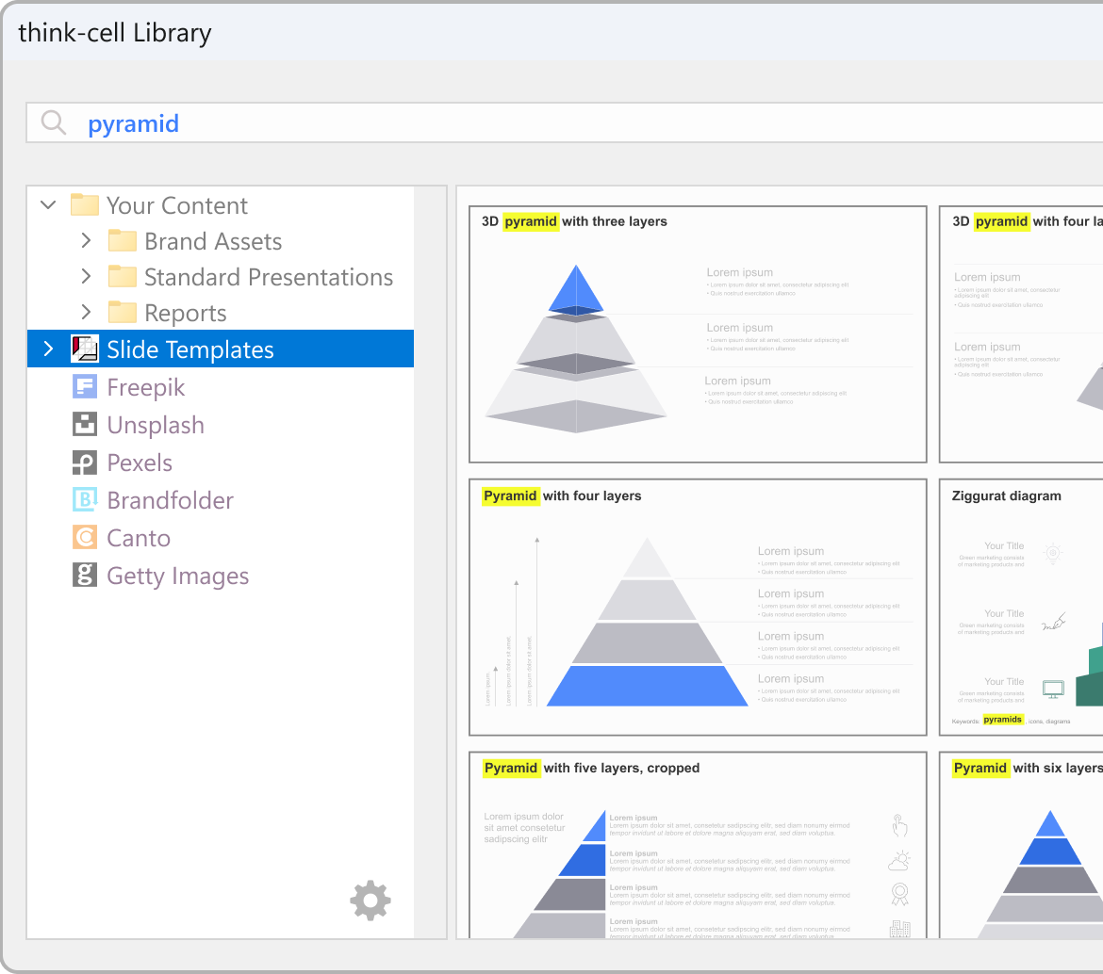
Searching for content
Enter search terms in the search box
match
Highlighted slide text
Identify text matches highlighted in slide thumbnails
Filter and sort search results
Specify date range, layout, etc. and sort for better results
Hide duplicate slides
Hide visually similar slides in your search results

